Slide 1
MODULE A UNIT A4

Slide 2

PRONOUNS

Slide 3
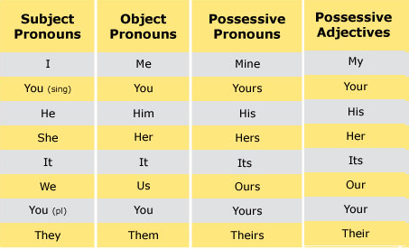
A pronoun is a word that takes the place of a noun.

Slide 4

Personal pronouns (also known as subject pronouns) are used as the subject of the sentence.
Examples:
I like your dress. You are late. He is my friend It is raining She is on holiday We live in England. They come from London.

Slide 5

Personal object pronouns are used as direct objects, indirect objects, or objects of prepositions.
as the object of the verb:
Can you help me, please? I can see you. She doesn’t like him. We saw them in the park yesterday, but they didn’t see us.
• after prepositions:
She is waiting for me. Give it to him. Why are you looking at her? I’ll speak to them.

Slide 6

Possessive pronouns are used to show ownership or relationship.
We can use a possessive pronoun instead of a noun phrase:
Is that John’s car? No, it’s mine.
Whose coat is this? Is it yours?
Her coat is grey, mine is brown.
We can use possessive pronouns after of.
Susan is one of my friends. or Susan is a friend of mine.

Slide 7
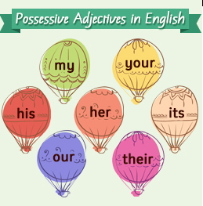
Possessive adjectives modify the nouns that follow them.
Change your password please.
She is my sister, her name is Sue.
They sent their email yesterday.

Slide 8
Choose the right option.
The teacher always gives the students homework.
me
them
you
My father is writing a letter to John.
me
her
him
I don't know the answer.
it
him
her
Can you help my sister and me, please?
them
her
us

Slide 9
Complete the sentences using a possessive adjective or pronoun.
1- 'I can't find _____ umbrella. Can I borrow _____ ?' 'Of course, take it.´
2-We live in this house. It's _______ .
3-Tom has taken ______ car to the garage to be repaired.
4-I share the bedroom with _______ sister. ______ room is very big and cozy.
5-The teacher is angry because the students haven't done ______ homework.
6-I have my passport but Jane has lost _______ . She needs to take a new one to go with me on holiday.

Slide 10
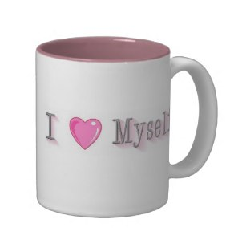
Reflexive pronouns

Slide 11

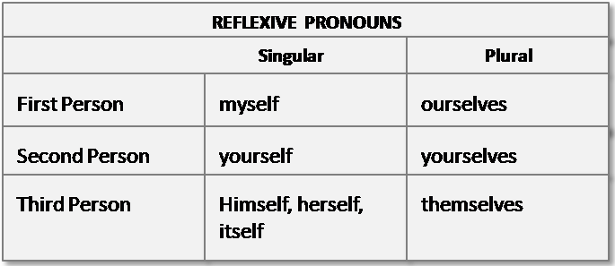

Slide 12
Reflexive pronouns reflect (turn back) the action done by the subject. In other words, the subject of the sentence is the same as the object of it:
I hurt myself with a knife while cutting vegetables.
We blame ourselves for the mistake.
Reflexive pronouns are used as objects of a preposition referring to the subjects:
John talks to himself when he’s nervous.
The children got dressed by themselves.

Slide 13
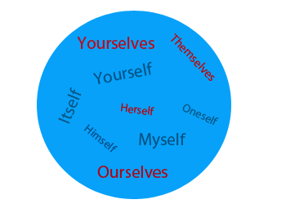
Reflexive pronouns are used when you want to emphasize the subject, in this case they have an intensive meaning. They can be omitted from the sentence without changing its meaning:
I baked it myself. (on my own)
I know her, she will do the project herself. (no one else will help her)

Slide 14
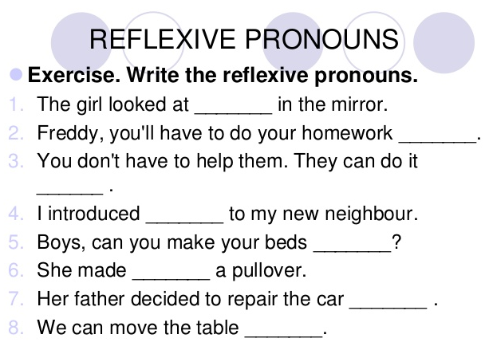

Slide 15
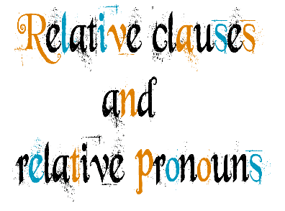

Slide 16
Relative pronouns introduce relative clauses. A relative clause tells us which person or thing the speaker means/ refers to. The two sentences can be linked into one.
We use a relative pronoun to substitute, for example, a common item in two sentences and join these two sentences in one.
Sue is a doctor. She works in the local hospital.
Sue is a doctor who works in the local hospital.
The Internet is a novel tool. It helps us to do things faster.
The Internet is a novel tool which helps us to do things faster.

Slide 17
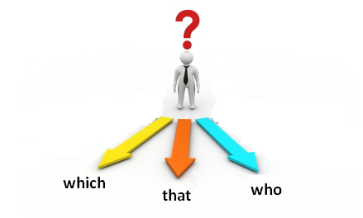
Who / that: refer to people.
The people who /that live next door have 6 children.
Emi is a student who is studying English.
Which / that: refer to things or animals.
A turtle is an animal which / that lives in the sea.
That company is the one which makes agrochemicals.

Slide 18


Slide 19
Reflexive pronouns.
http://www.ompersonal.com.ar/omgrammar/pronombresreflexivos.htm
http://www.englishexercises.org/makeagame/viewgame.asp?id=1327
http://www.englisch-hilfen.de/en/exercises/pronouns/reflexive_pronouns.htm
http://www.agendaweb.org/grammar/reflexive_reciprocal_pronouns-exercises.html
Relative Pronouns. Relative Clauses.
http://www.ompersonal.com.ar/INTERMEDIATE/unit14/page5.htm
http://www.ompersonal.com.ar/omgrammar/pronombresrelativos.htm
http://www.englisch-hilfen.de/en/exercises/pronouns/relative_pronouns.htm
http://www.agendaweb.org/grammar/relative_pronouns_clauses-exercises.html
http://www.ompersonal.com.ar/INTERMEDIATE/unit14/page7.htm (Reading Comprehension)

